Slide 1
The Arthropods
You puny humans only think you are in charge!

Slide 2
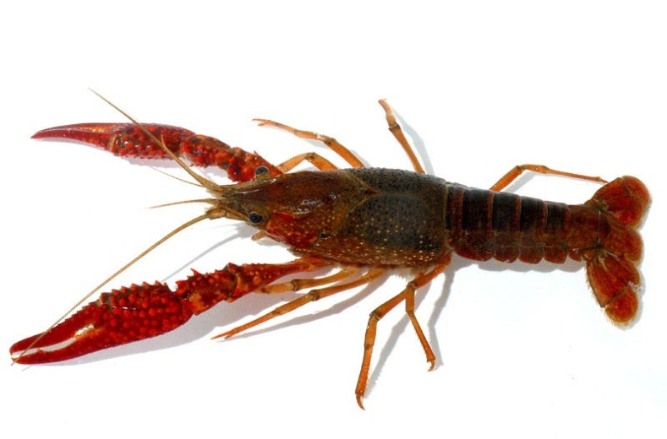
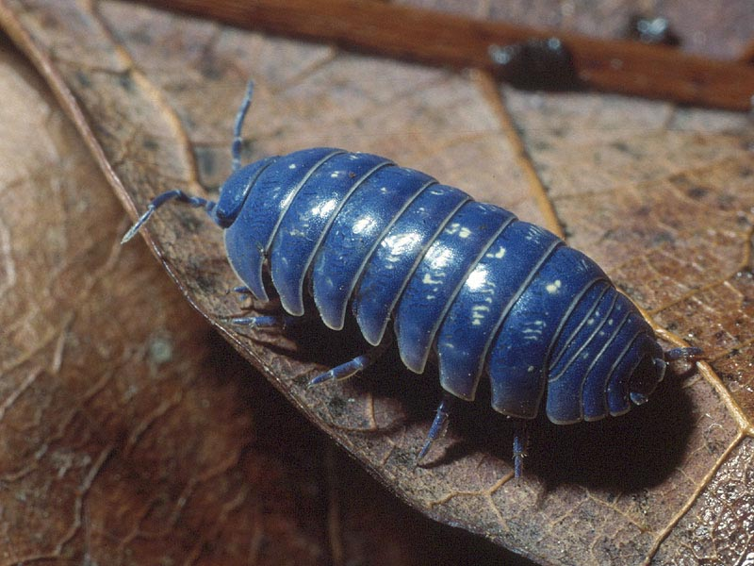
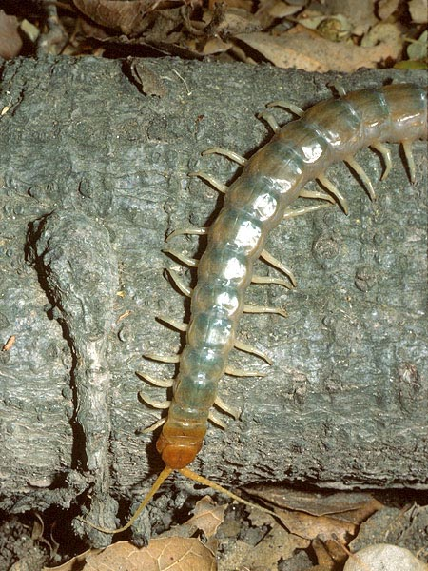
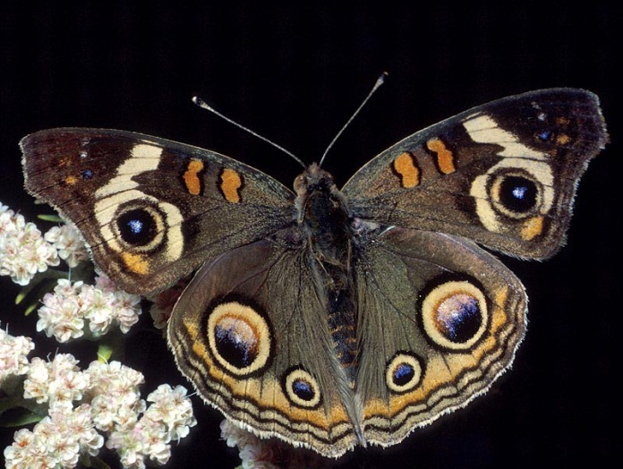
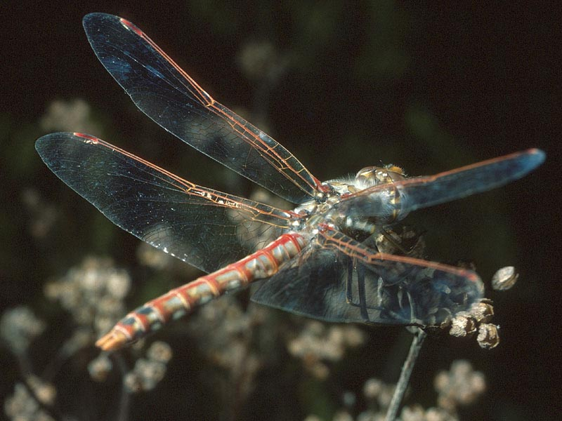
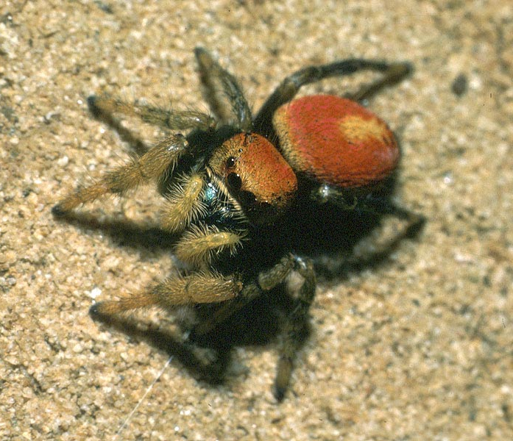
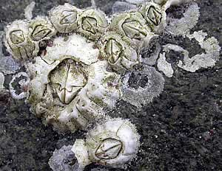
The Basics

Slide 3
What makes an Arthropod?
Triploblastic
Bilaterally symmetrical
Segmented body
Chitinous exoskeleton
Jointed appendages
Specialization of appendages
Coelom acts as open circulatory system (hemocoel)
Growth through molting

Slide 4
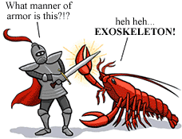
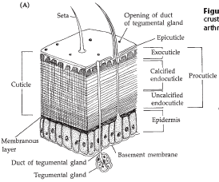
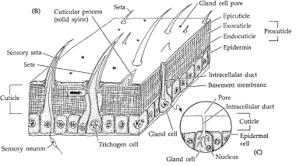
The Exoskeleton
Notes:
Point out epicuticle, procuticle, tanning of proteins, waterproofing thus no cutaneous respiration

Slide 5
Molting
Hardened Exoskeleton presents problems for growth
Ecdysis: removal of the exoskeleton (molting)

Slide 6
Jointed Appendages
Notes:
Highlight extensor and flexor muscles and contrast with vertebrate muscles

Slide 7
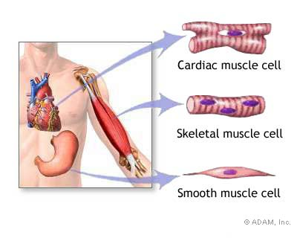
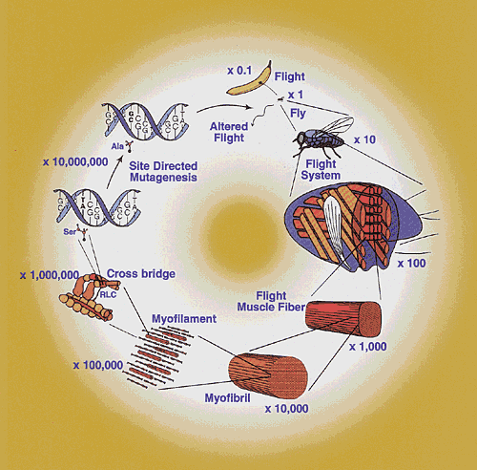
Arthropod Muscles

Slide 8
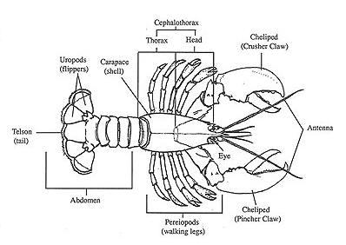
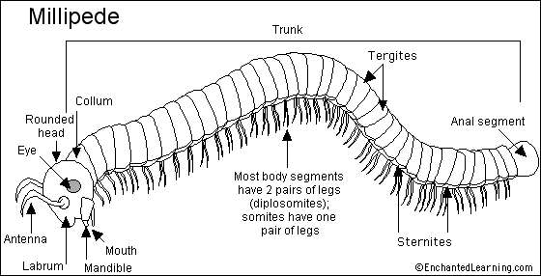
Appendage Adaptablity

Slide 9
Limits to Size
The Physics of Growth

Slide 10
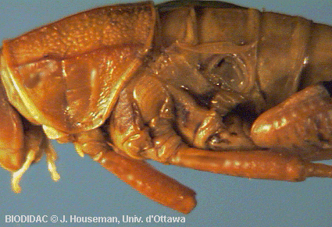
Arthropod Nervous System
“Brain” is 2-3 ganglia with specific functions.
Ganglionated ventral nerve cord.
Sense organs (sensilla) protrude out of cuticle.
Can be slit in cuticle.
Membranous drums.
Chemoreceptors with thin cuticle.

Slide 11
Arthropod Circulation

Slide 12
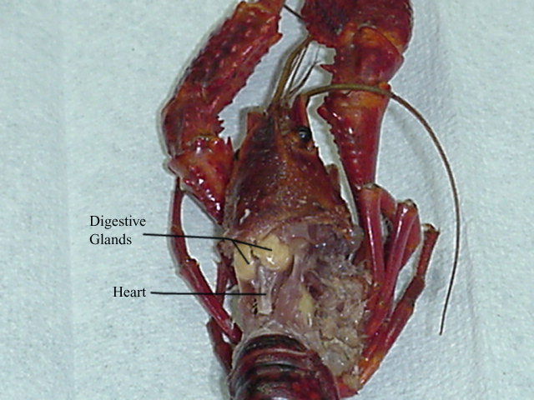
Circulation Cont.
Open circulatory system
Heart contains ostia
Blood= “Hemolymph”, contains white blood cells, oxygen binding pigments and some clotting factors

Slide 13
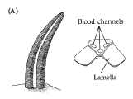
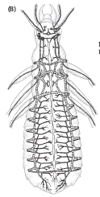
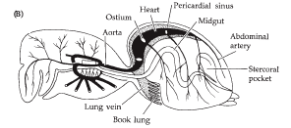
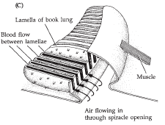
Arthropod Respiration
Respiratory structures depend on habitat.
Trachea in terrestrial insects.
Gills in aquatic animals.
Arachnid book lung.

Slide 14
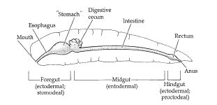
Feeding and Digestion
Complete gut with regional specialization.
Foregut - food intake, transport, storage, mechanical digestion (jaws, pharynx, gizzard).
Midgut - extracellular digestion, nutrient uptake (cecae, digestive gland, hepatopancreas).
Hindgut - excretion of undigested material, water reabsorption.

Slide 15
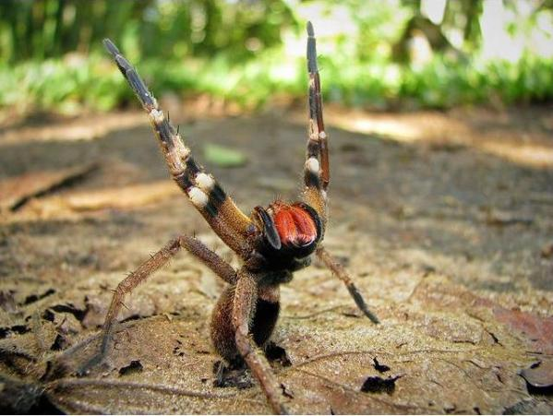
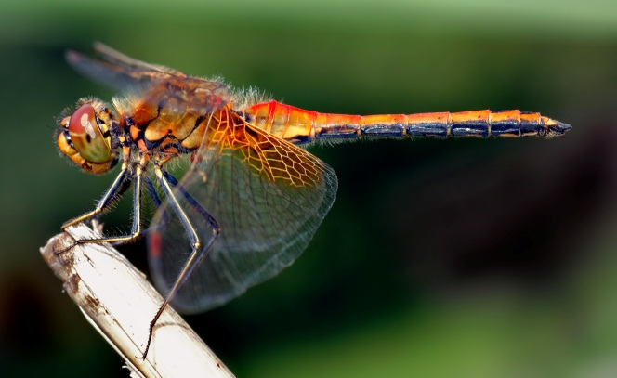
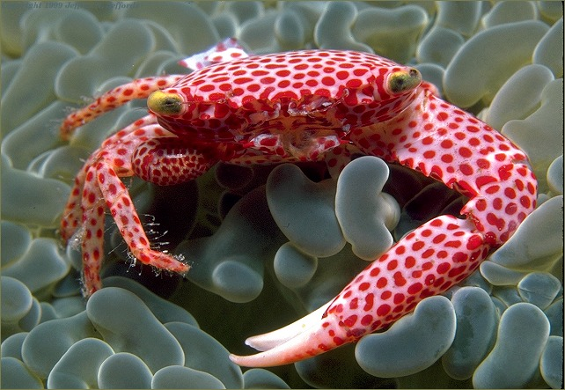
Arthropod Phylogeny and Diversity
Most diverse and populous of all phyla
Oldest land animal phyla
Over 1,000,000 named species
Estimated >10,000,000 extant species
95% fall into three major classes: Arachnida, Insecta, and Malacostraca (formerly Crustacea)

Slide 16
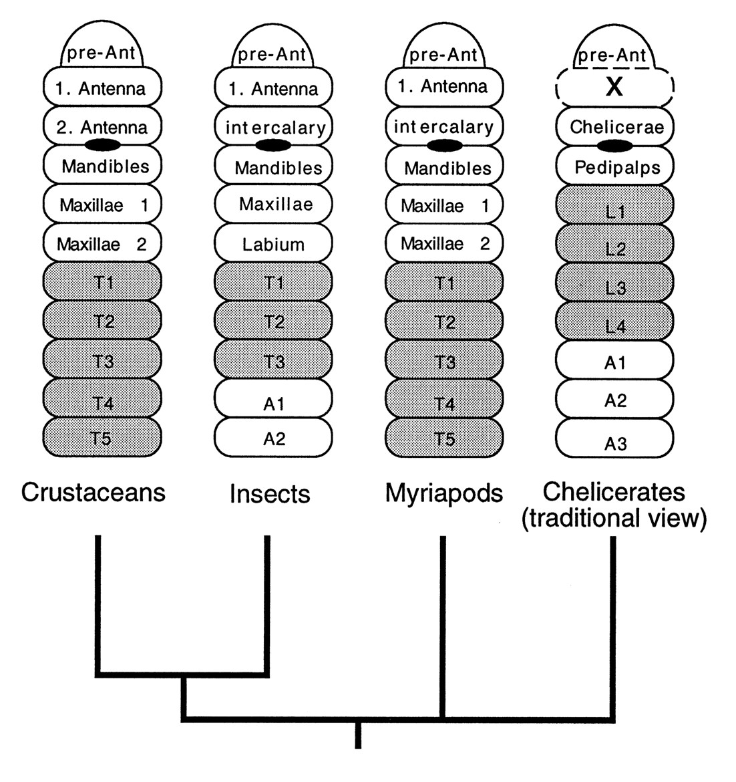
Phylogenetic scheme of the major arthropod groups and modes of head segmentation.
Damen W G M et al. PNAS 1998;95:10665-10670
©1998 by National Academy of Sciences
Notes:
Phylogenetic scheme of the major arthropod groups and modes of head segmentation. The phylogeny depicted is based on molecular data (4, 5); the depiction of the head segments represents a consensus from textbooks (1, 34). The segments are labeled according to the conventions in the respective taxa; leg-bearing segments are shaded. The position of the mouth is indicated by a black oval. The presumed missing segment in the chelicerates is marked with an “x”. The drawing is modified from Willmer (34).

Slide 17
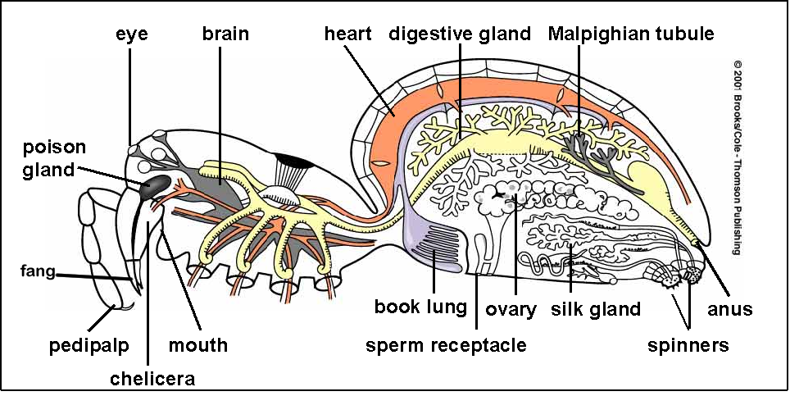
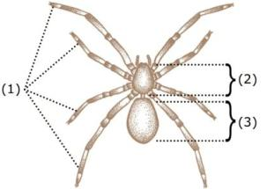
Class Arachnida
Body regions combined into groups (tagmata): abdomen and cephalothorax
Limb arrangement: Chelicerae, pedipalps, 4 pairs of walking legs
No antennae or mandibles
Poison glands
Externally liquefy food and suck it up
Most adapted for land of Arthropods

Slide 18
Set of 6-8 simple eyes
Sensory setae

Slide 19
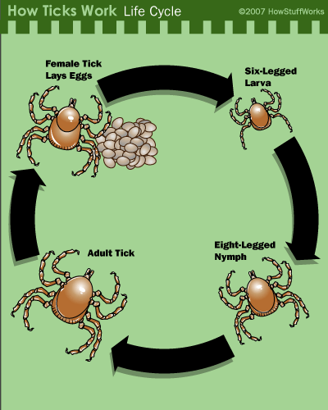
Development and Life Cycle

Slide 20
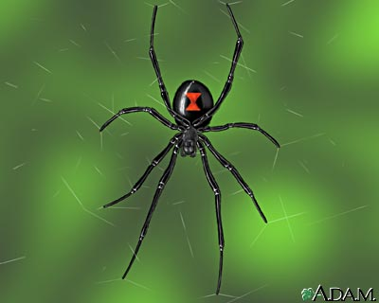
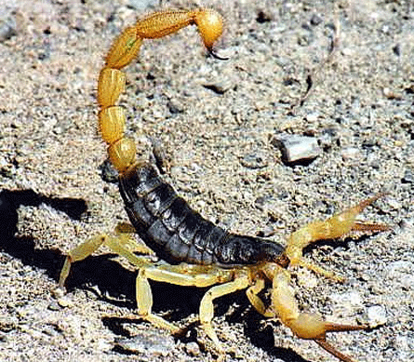
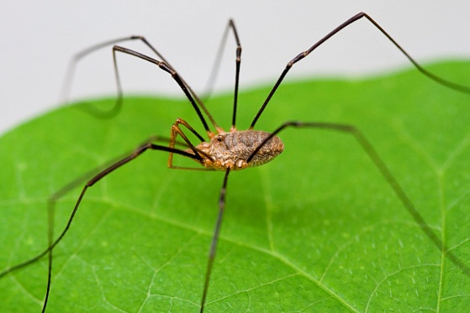
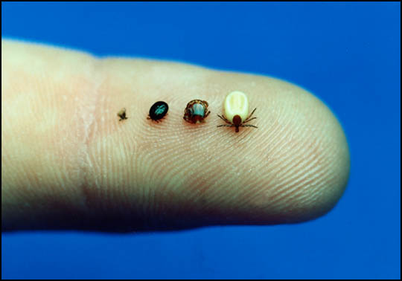
Major Orders of Arachnids:
Araneae: Spiders
Scorpionida: Scorpions
Opiliones: Harvestmen
Acari: Ticks and Mites

Slide 21
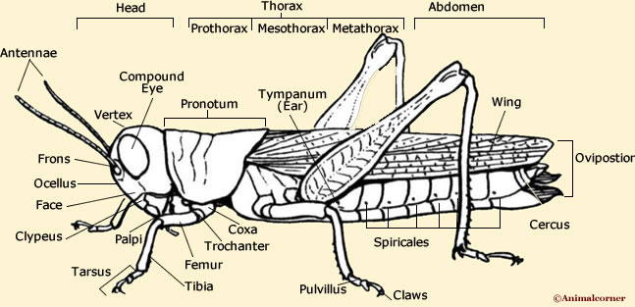
Class Insecta
More species of insects than all other classes of animals combined
Three pairs of walking legs
Two pairs of wings
Three tagmata: head, thorax and abdomen
Large paired compound eyes
Three ocelli: light sensing pits
Gas exchange through spiracels connected to tracheae

Slide 22
Insect Development
Holometabolous Metamprphosis
Hemimetabolous Metamorphosis

Slide 23
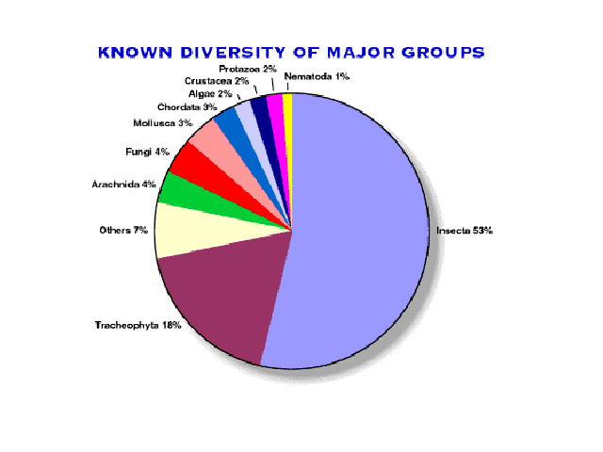
Diversity: Too big to count!!!
27 Major Orders!
Order Orthopetra: grasshoppers, crickets and cockroaches
Order Lepiodoptera: Moths and butterflies
Order Diptera: true flies
Order Hymenoptera: Ants bees and wasps

Slide 24
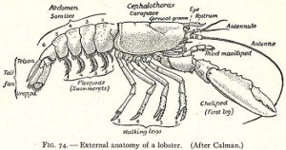
Class Malacostraca
Two pairs of antennae
Paired mandibles with maxillae
Most segments bear appendages
Fused rostrum at the cranial end
Tail=telson and uropods
Head and thoracic regions fused into carapace

Slide 25
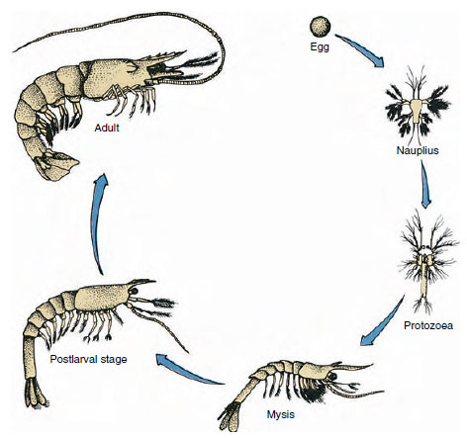
Development and Lifecycle
Fertilized egg hatches into nauplius larva
Series of molts leads to development into an adult

Slide 26
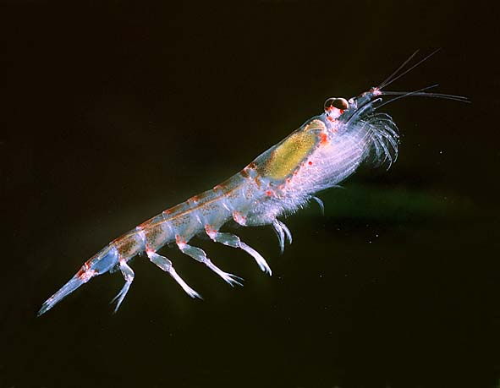
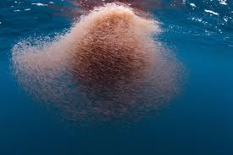
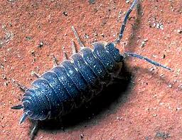
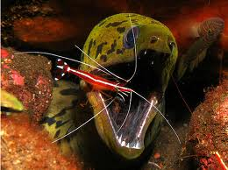
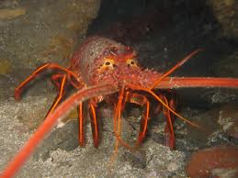
Malacostracan Diversity
Order Isopoda: sow bugs and pill bugs
Order Euphausiacea: krill
Order Decapoda: shrimp, crabs and lobsters

